Slide 1
Diurnal Temperature Cycles

Slide 2
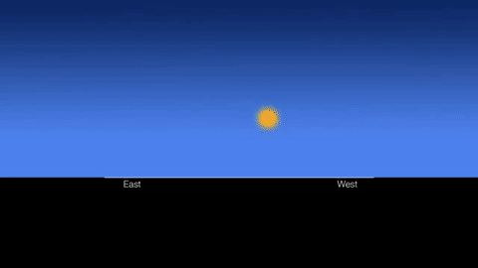
Diurnal Cycle
As the Earth rotates, the sun rises in the East and sets in the West. This is called the diurnal cycle.
The length of a day and the total amount of energy received over the course of a day depends on latitude and season.

Slide 3
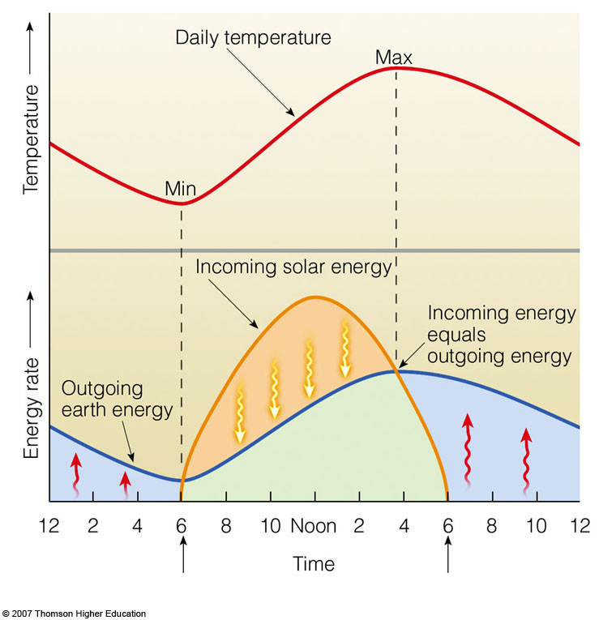
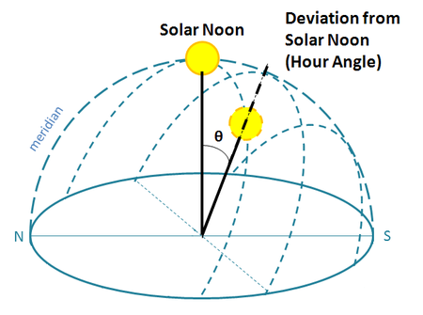
Solar Noon
The change in angle of the sun throughout the course of the day causes temperature to vary, with the hottest part of the day usually occurring after the sun has reached its peak angle in the sky (a.k.a., solar noon).

Slide 4
Land Heating
Remember that land heats up and cools off faster than water.

Slide 5
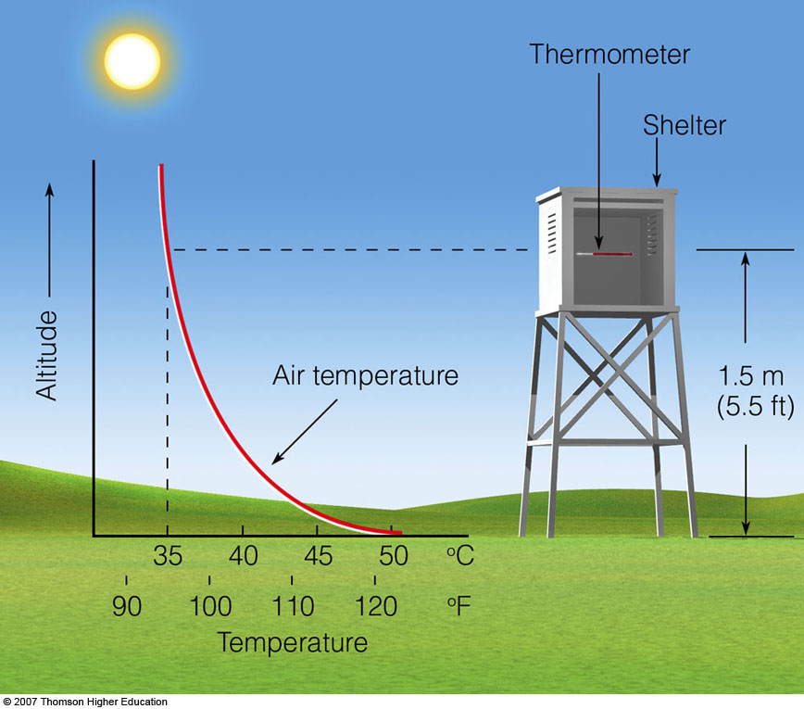
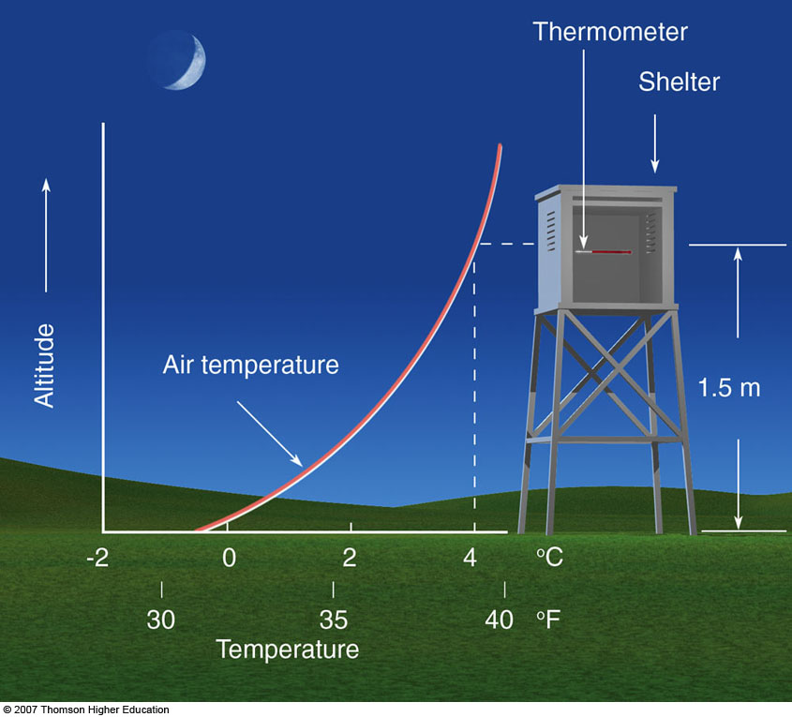
Temperatures at Night
After the sun goes down the Earth emits radiation, which means the coolest part of the day generally occurs just before sunrise.

